Slide 1
SHUBHAM SOLANKI-92000133040 HUZEFA DHANKOT-92000133021 B.TECH ICT SEM-6 SUBJECT-AI PROJECT: CIRCUIT COMPONENT DETECTION USING R-CNN

Slide 2
Introduction
The goal of the project is to develop an AI model based on RCNN architecture to detect electrical circuit components from images.
This is important because it can help automate the process of circuit component recognition, which is critical for many industrial applications, including electronics manufacturing, maintenance, and repair.
RCNN stands for Region-based Convolutional Neural Network, which is a deep learning architecture that can learn to recognize objects in images by first proposing regions of interest and then classifying them using convolutional neural networks.
The RCNN architecture consists of three main components: a region proposal network, a convolutional neural network, and a fully connected network.

Slide 3
Understanding RCNN
The RCNN architecture is one of the most popular and effective approaches to object detection in computer vision.
It has several advantages over other methods, including high accuracy, robustness to occlusion and clutter, and the ability to learn object representations in an end-to-end manner.
However, it also has some limitations, including high computational and memory requirements, slow inference speed, and difficulty in training on large-scale datasets.
RCNN has been successfully applied to a wide range of applications, including face detection, pedestrian detection, object tracking, and text recognition.

Slide 4
Data preparation and model training
To train an RCNN model for electrical circuit component detection, you need to prepare an annotated dataset of images and corresponding labels indicating the location and class of each component in the image.
The dataset should be split into training, validation, and test sets to ensure proper training, evaluation, and testing of the model.
You can use tools such as LabelImg or VGG Image Annotator to annotate the images and generate the required annotations in the Pascal VOC format.
The RCNN model can be trained using a pre-trained convolutional neural network such as VGG16 or ResNet50, which can be fine-tuned on the annotated dataset using backpropagation and stochastic gradient descent.
The training process can be done using popular deep learning frameworks such as TensorFlow, Keras, or PyTorch, which offer pre-built implementations of the RCNN architecture.

Slide 5
Evaluation and analysis
To evaluate the performance of the trained RCNN model, you can use metrics such as precision, recall, and F1-score, which measure the accuracy, completeness, and overall performance of the model.
You can also use visualization tools such as confusion matrices, precision-recall curves, and ROC curves to analyze the errors and limitations of the model and identify areas for improvement.
To improve the performance of the model, you can try different hyperparameter settings, adjust the learning rate, or use data augmentation techniques such as flipping, rotation, and scaling to increase the diversity of the training data.

Slide 6
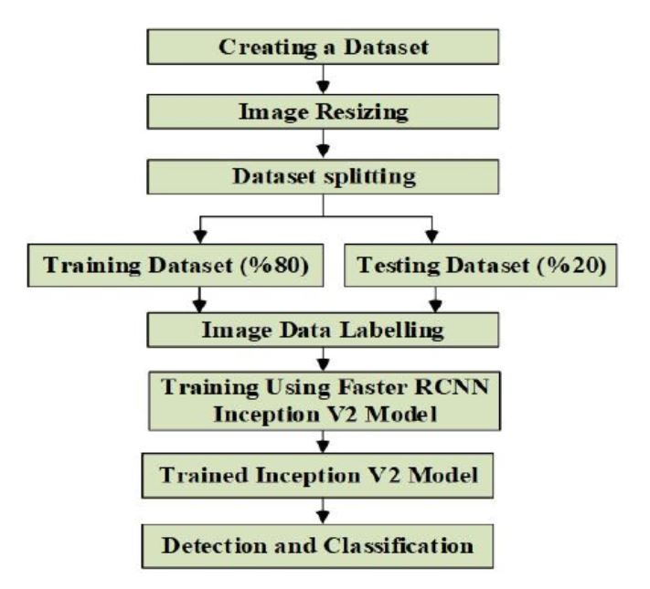
FLOWCHART

Slide 7
Future use and applications
The trained RCNN model can be used in many real-world applications, including automatic circuit component recognition, quality control, and maintenance.
For example, it can be used to automatically detect and classify faulty components in a manufacturing line, or to inspect the condition and quality of components in a circuit board.
The model can be extended to other related tasks, such as object counting, instance segmentation, and multi-class object detection, which can further improve its usefulness and applicability.

Slide 8
Conclusion
The project demonstrates the effectiveness and potential of the RCNN architecture for electrical circuit component detection.
REFRENCE LINK: https://www.researchgate.net/publication/357067777_Detection_of_circuit_components_on_hand-drawn_circuit_images_by_using_faster_R-CNN_method
https://www.researchgate.net/publication/357448811_Recognition_of_Electronic_Circuit_Components_Using_a_Modern_Convolutional_Object_Detector

